Slide 1
Online Student Activeness System
By Abhishek Sharma(191258)
Shivam Singh Negi(191260)

Slide 2
Motivation
As we all know that covid-19 has put a major setback on the Indian education system. There is a lack of seriousness among students while attending the online classes. Most of the students join the class just for attendance and thereafter go for their own works i.e playing games , sleeping. The teacher continues to teach without knowing what students are doing at other end. It is just like talking to the walls. There is no point in teaching in such a way where no one is listening and in exams its easy to just copy paste from the google. Also, if the teacher ask question to each student one by one it would take a lot of time. Thus we can’t really judge the performance of the students. Such an education is useless from which no one is getting benefited. Its just a waste of time and efforts.

Slide 3
Introduction
Online Student Activeness System is a model which can help the teachers to check the performance of the students on daily basis. Teachers can evaluate the students in online mode just like they are physically present in the classroom. They can know how many students are actively present in the class and how many of them have join the class for just the sake of attendance. It also helps the teachers to know how much students are able to understand from what he is teaching. Teacher will be getting the data of every student from time to time and from there he/she can easily sort out the students who are not there. It also stores the data onto a csv file on the teachers computer thereby for the future reference (for giving internal marks).

Slide 4
Software Requirements
1 GHz CPU (min)
1 GB RAM (min)
250 MB Disk space + space for data + index files
PyCharm for implementing python code
Virtual machine (to implement client-server on same machine)(optional)

Slide 5
Objective
The main objective of the program is to check the activeness and performance of students in online classes. The system will ask the students a set of random questions selected from database at any instant of time during the class. The total no of questions answered and no of questions answered correctly will be stored in an csv file against the student enrollment number. Each subject has a unique code and each csv file will be saved by the name of the code.
Each student will be given a time slot to answer the question. If he/ she is able to answer in the given time slot his/her result will be accordingly stored in the file.
A client server model has been created where teacher act as server and students are clients.

Slide 6
Database
The database will be self created by the teacher.
As mentioned earlier the questions to ask from the student will be picked up from a database and each subject has a unique code. The database of question will be created for each subject and is stored by name Subjectcode_database.
The database can be created with the help of web scrapper made in python from google for a particular website(for our project we have extracted from www.sanfoundry.com).
We have created the database for few subjects for the use of our project.
Teacher can create their own web scrapper to extract the data from internet(for different sites) or they can create their own set of questions.

Slide 7
The database created are:
Operating system
Database management and systems
Compiler design
Data structures and algorithm

Slide 8
Flowcharts
.

Slide 9
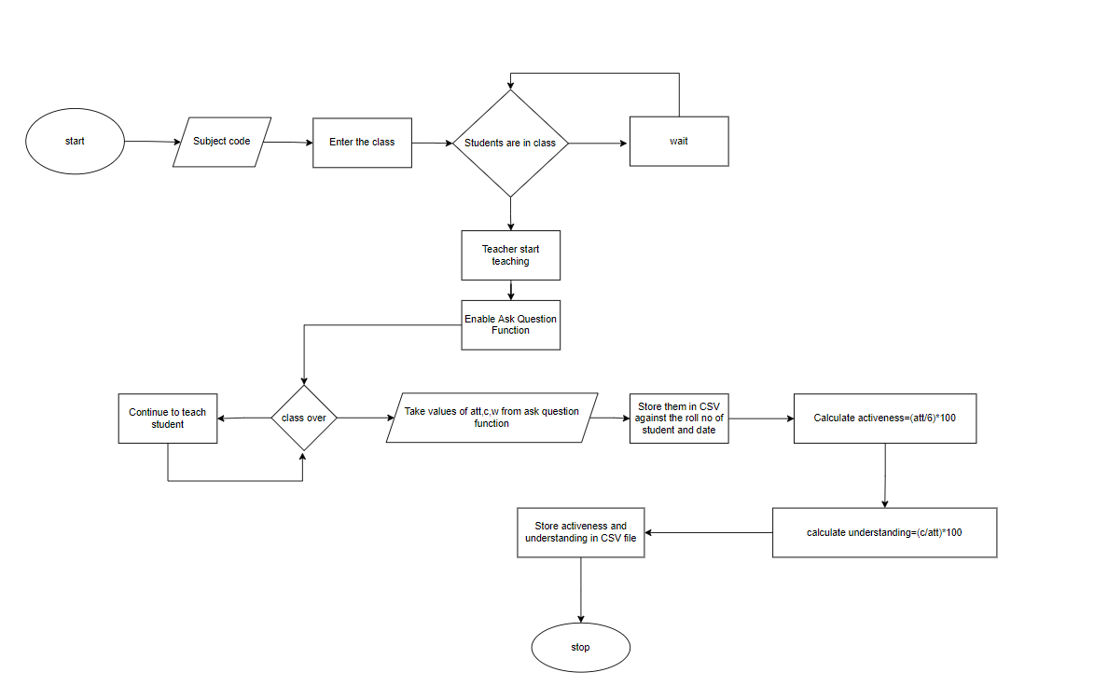
Server(Teacher) Side
no
yes
no
yes

Slide 10
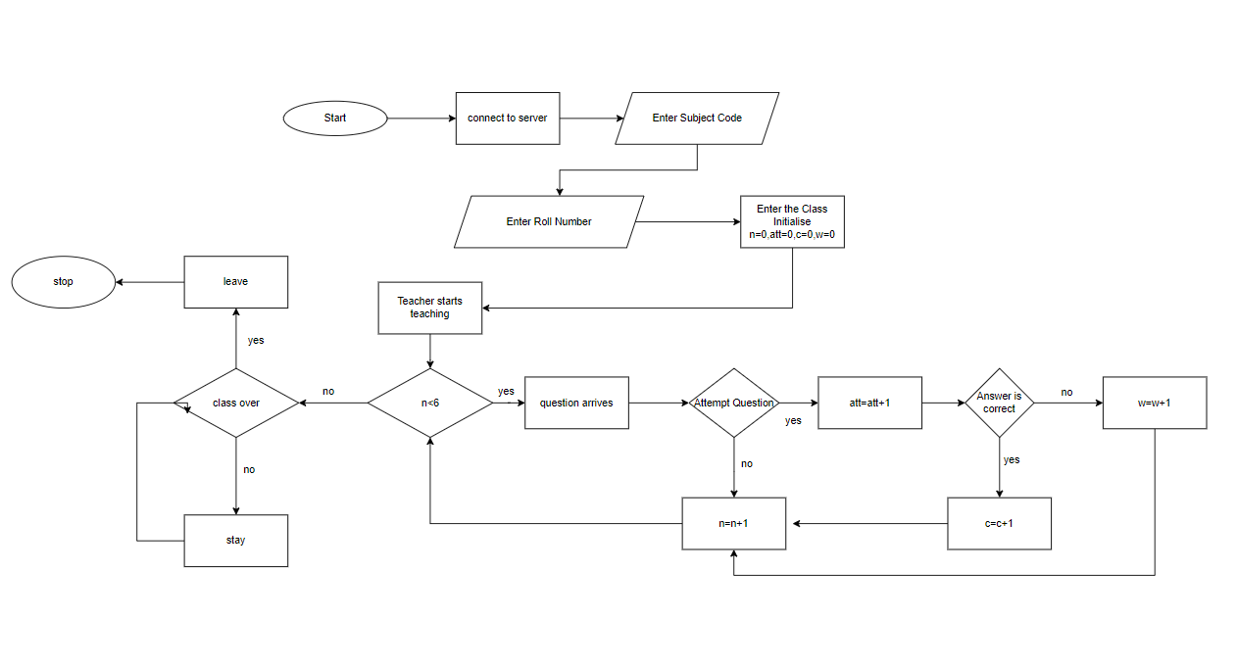
Client(student) side

Slide 11
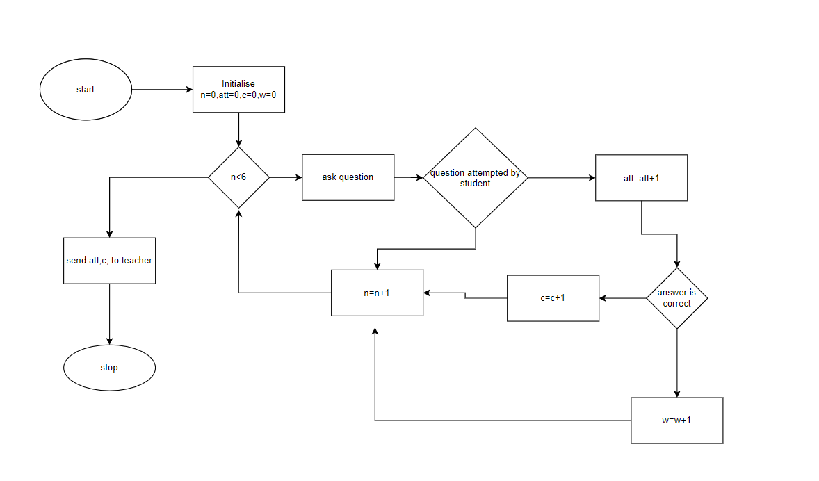
Ask question function
no
yes
yes
no
yes
no

Slide 12
Literary Survey
Basically we have created a client server model as mentioned earlier with the help of socket programming in which kali machine (as in our case ) is acting as the server where all data from users will be collected in CSV file and windows 10 is acting as an client.
The database created with the help of web scrapper . We have used “Beautiful Soup” library to extract the data from the html websites(www.sanfoundry.com in our case).
Pandas library has been used to store the data in csv file
Numpy has been used to create the array of students enrolled in class

Slide 13
Result
The final outcome is an interactive platform between teacher and students allowing them get an exposure among themselves while being in the online mode.
Teacher will get the results of each student thereby checking the performance of each student and he/she can grade the accordingly.
The client server model created allows data collected from multiple users to accumulate at one place.

Slide 14
Future Scope
The databases created with the help of web scrapper can be collaboratively used to create a MCQ quiz platform for various competitive exams.
Furthermore, recommendation system can be added to the model helping teacher how to increase student interaction in class by the help of collaborative filtering algorithm of machine learning.
This model could be added to Google meet as it is widely used online teaching platform.

